Slide 1
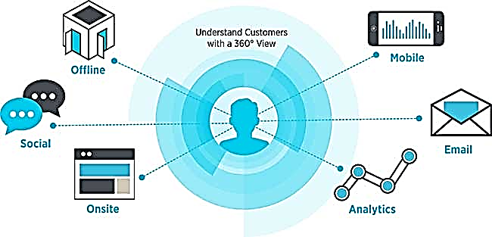

Customer 360^{ο}
June 2016

Slide 2

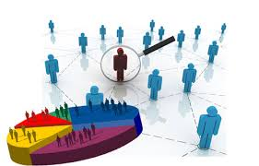

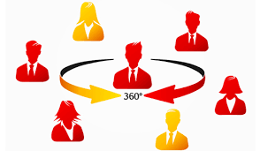





Background
The 360-degree customer view is a complete view of customers by aggregating data from the various touch points that a customer may use to contact a company to purchase products and receive service and support or touch points that a company uses to connect with the Customer
GAP Databases
Analytics Services
Transaction Data
BI & Reporting
Browse Activity
Predictive Analytics
360 degree view of Customer
Evergreen Attributes
Advertising, Marketing & Campaigns Data
Prescriptive Analytics
Social Media
Sentiment Analysis

Slide 3

Customer 360⁰ : Different users looking through different lens
Customer data aggregation is done at different granularities for different users
End users can vary from Store Rep., Campaign Manager(below the line), Channel Manager (above the line), Operation’s Strategist, Customer Strategist etc.
Operations Strategist
Customer Strategist
Campaign Manager
Channel Manager
Store Rep

Slide 4















Store Rep’s View- Know your Customer like a friend
Revenue($) | 680
# of Purchases | 5
# of Returns | 1
% Disc. availed | 15%
Online Rev. | 18%
Store Rev. | 82%
Avg. ticket size | 80
LAST 6 MONTHS
Life cycle Stage | Active
LTV Segment | H
Customer Seg. | Uber
Attrition Prob. | M
s
0/1
1/2
NA
1 | 0 | 0
Prob. To buy | H
Divisions | Women, Acc.
Tenure | 3 Y
Acq. Brand
Discounts Sensitivity | L
Card Status
EM
EM
DM
E
E
M
P
B
S
Future
Past
Present
Purchase
Kids- 40%
Women-50%
Acc-10%
Browse
Social Media
GP Brand Promotion
Kids
Women

Slide 5
Store Rep’s View- Use Cases
# | Use Case Epic Story | Capabilities Required
1 | The SA makes Product Recommendations ,as soon as the Customer is identified in the system | Ability to load recommendations from Predictive Models like Recommender Engines
2 | The SA knows the recent online activity (browse history / cart abandonment) of the customer, as soon as the Customer is identified in the system. The SA can engage with the customer based on products identified from the interactions | Ability to load data from Browse History/Cart abandonment
3 | The SA knows the recent return (Product Desc.) by the customer, as soon as the Customer is identified in the system. The SA engages with the Customer understanding the reason for return | Predictive Model which recommends similar products available in the Store Ability to load recommendations from the Predictive Model
4 | The SA knows about the recent feedbacks/social media from the customer, as soon as the Customer is identified in the system. | Ability to load data from feedbacks/social media activity
5 | The SA knows about the Discount Sensitivity of the customer, as soon as the Customer is identified in the system. This provides a basis for offering/not offering additional discounts(if possible) | Ability to load recommendations from Predictive Models predicting Discount Sensitivity
6 | The SA knows about the PLCC Redemption Points of the customer, as soon as the Customer is identified in the system. This gives the SA an opportunity to notify customer about how and when the points can be redeemed | Ability to load data from PLCC spends
7 | The SA knows the Loyalty Status (Acquired/Not Acquired) of the customer, as soon as the Customer is identified in the system. The SA can then seek consent from the Customer | Ability to load data from Purchase History and Loyalty enrollment

Slide 6
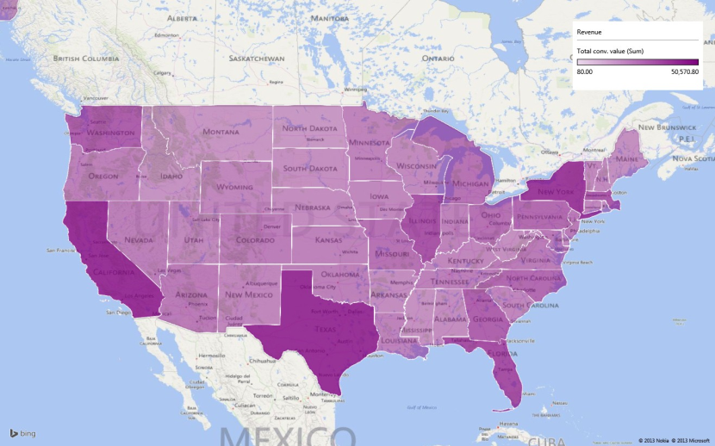
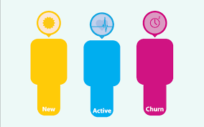
Strategist’s View – Where are we heading to?
Weeks before Q_{next} = 5
Quarterly Target
Online
DELTA
REVENUE DISTRIBUTION
Store
3M
14M
8M
Q₋₄ Q₋₃ Q₋₂ Q₋₁ QTD

Slide 7
Operational View – How can the Marketing Spend perform better?
High ROI and very low diminishing return effect. Spend on this channels should be increased
At the current level of spend the marginal returns are very low. Reduction in SEM and email should be considered
International Sales
Spend
Carry over effects by activities

Slide 8

Customer’s Voice– What are the Customer’s talking?
SOCIAL MEDIA LISTENING
9.34% POSITIVE
90.66% NEUTRAL
0.00% NEGATIVE
Customer satisfaction

Slide 9
Strategist’s View - Use Cases
# | Use Case Epic Story | Capabilities Required
1 | The CXO knows the current Customer Lifecycle distribution(New/Active/Churn). He can identify focus areas – Acquisition/ Control churn/ Increase Active Engagement | Ability to aggregate and load data from Customer Acquisition and Transactions
2 | The CXO knows the current Geographical distribution (Revenue/Customer Count/Complains/Promotion Response). He can identify focus geographies | Ability to aggregate and load relevant data
3 | The CXO knows the trend of key Business Metrics (Revenue/Customer Count/Complains/Promotion Response). He can identify focus areas/strategy for improvement/growth | Ability to aggregate and load relevant data
4 | Investment decision by Brand
5 | Cross Cannibalization
6 | Social Media listening – react to a viral online post/s
7 | Feedback themes
8 | Investment on New Technology Platform (e.g.: Mobile)

Slide 10
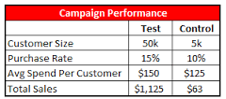

Campaigner’s View – How Campaigns perform ? (Below the line)
Month over Month Performance of Campaign
Revenue ($ 100k)
# of Coupons redeemed
Sales

Slide 11
Campaigner’s View – How Campaigns perform ? (Above the line)
Comparing day parts
Internet’s reach is more than TV between 6 and 8 AM

